Slide 1
CONFIDENCE INTERVALS

Slide 2
Assume some familiarity with
Normal distribution/Standard Normal Distribution
Standard Deviation
Central Limit Theorem

Slide 3

We take a sample of data from dataset with any kind of distribution
And takes its mean $\hat{μ}$
Let’s go away from this for a bit and focus on Normal Distributions and the Central Limit Theorem

Slide 4
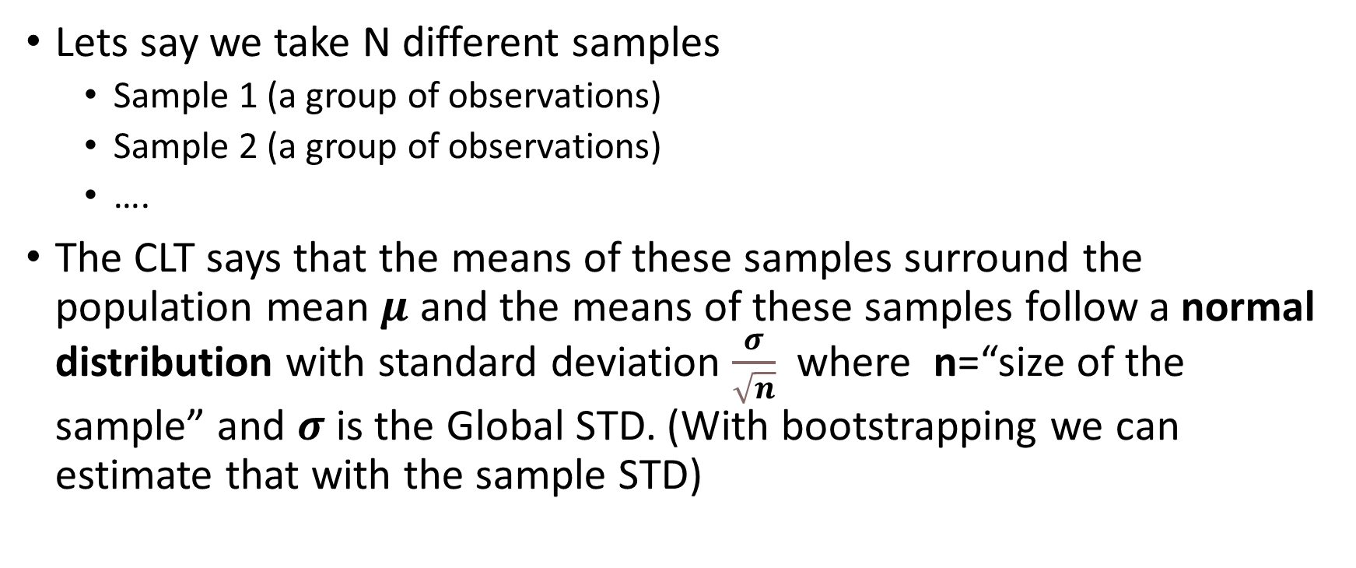
Central Limit Theorem
Lets say we take N different samples
Sample 1 (a group of observations)
Sample 2 (a group of observations)
….
The CLT says that the means of these samples surround the population mean $μ$ and the means of these samples follow a normal distribution with standard deviation $\frac{σ}{\sqrt{n}}$ where n=“size of the sample” and $σ$ is the Global STD. (With bootstrapping we can estimate that with the sample STD)

Slide 5
Normal distribution
Approximately 66 % of the data is 1 STD away from mean
Approximately 95 % of the data is 2 STD away from mean
Approximately 99 % of the data is 2.5.. STD away from mean

Slide 6
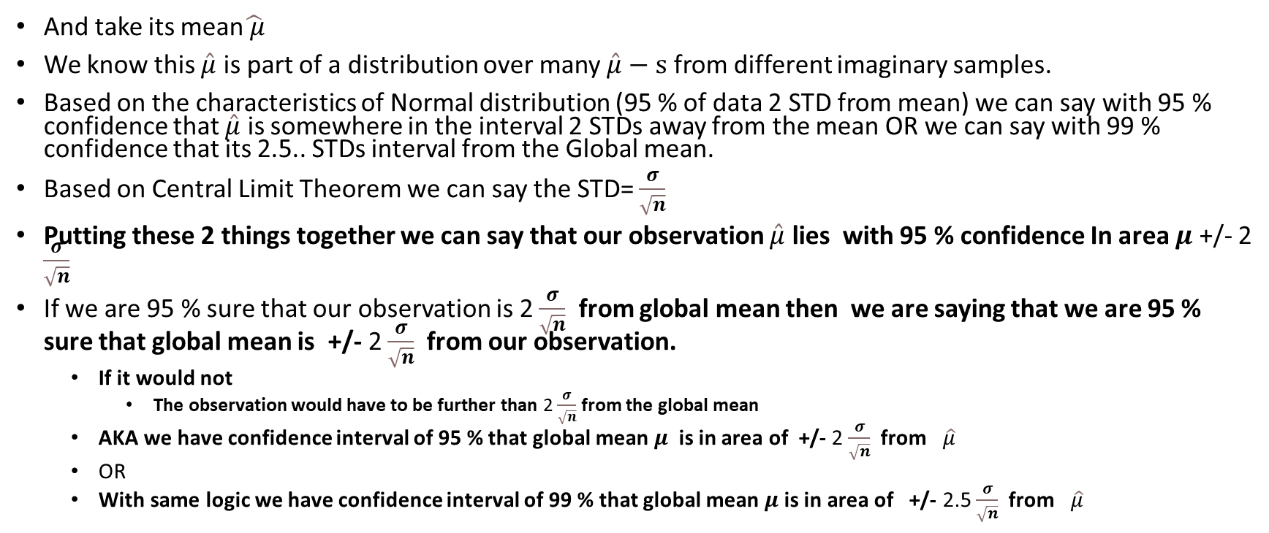
Coming back .. We take a sample of data from a random dataset with any kind of distribution and assume a 95 % confidence interval
And take its mean$\hat{ μ}$
We know this $\hat{μ}$ is part of a distribution over many $\hat{μ}−s$ from different imaginary samples.
Based on the characteristics of Normal distribution (95 % of data 2 STD from mean) we can say with 95 % confidence that $\hat{μ}$ is somewhere in the interval 2 STDs away from the mean OR we can say with 99 % confidence that its 2.5.. STDs interval from the Global mean.
Based on Central Limit Theorem we can say the STD= $\frac{σ}{\sqrt{n}}$
Putting these 2 things together we can say that our observation $\hat{μ}$ lies with 95 % confidence In area $μ$ +/- 2 $\frac{σ}{\sqrt{n}}$
If we are 95 % sure that our observation is 2 $\frac{σ}{\sqrt{n}}$ from global mean then we are saying that we are 95 % sure that global mean is +/- 2 $\frac{σ}{\sqrt{n}}$ from our observation.
If it would not
The observation would have to be further than 2 $\frac{σ}{\sqrt{n}}$ from the global mean
AKA we have confidence interval of 95 % that global mean $μ$ is in area of +/- 2 $\frac{σ}{\sqrt{n}}$ from $\hat{μ}$
OR
With same logic we have confidence interval of 99 % that global mean $μ$ is in area of +/- 2.5 $\frac{σ}{\sqrt{n}}$ from $\hat{μ}$

